Slide 1
Facial Recognition
Dan Kern

Slide 2
Facial recognition overview
What is facial recognition?
Facial recognition is a biometric software application capable of uniquely identifying or verifying a person by comparing and analyzing patterns based on the person's facial contours. [Source: https://www.techopedia.com/definition/32071/facial-recognition]
Uses
Building access
Unlock phones/computers
Identify customers
History
Dates back to the early 1960s
Developed by government and university research
Grown with the introduction of digital imagery

Slide 3
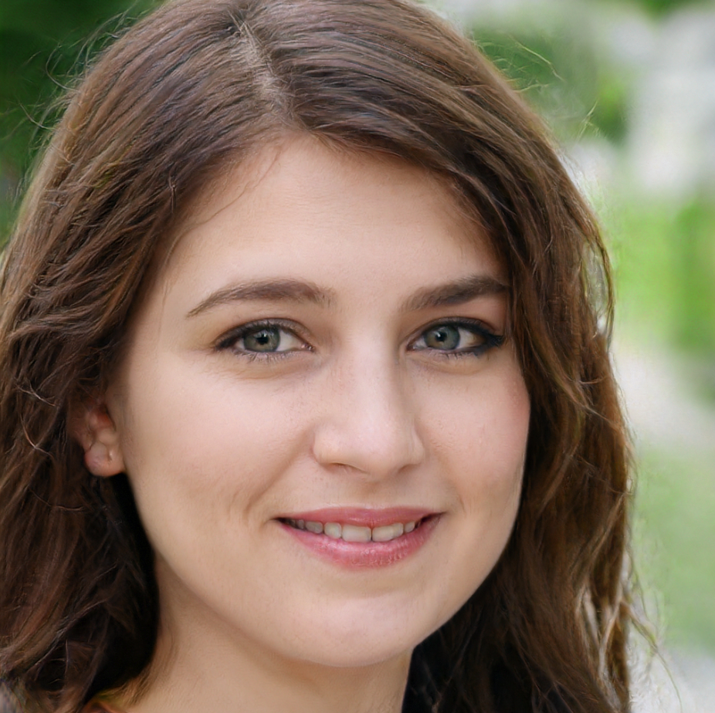
How facial recognition works
Image of face is captured
Facial features and “landmarks” are identified and quantified
distance between your eyes
distance from forehead to chin
Etc.
The facial signature - a mathematical formula - is compared to a database of known faces.
A determination is made: Does your “faceprint” match a record in the database

Slide 4
How facial recognition works
Image of face is captured
Facial features and “landmarks” are identified and quantified
distance between your eyes
distance from forehead to chin
Etc.
The facial signature - a mathematical formula - is compared to a database of known faces.
A determination is made: Does your “faceprint” match a record in the database

Slide 5
Instructions for this exercise
How well does your facial recognition “software” work?
You will be presented photographs of 10 different faces.
Each photograph has two occupations listed.
You will see if you recognize the face and then select the correct occupation.
If you do not recognize the face, you can look for features that may suggest the correct occupation

Slide 6
#1
Actress
Member of the 2012 US Women’s soccer team

Slide 7

#2
Politician
Founded a famous hedge fund

Slide 8
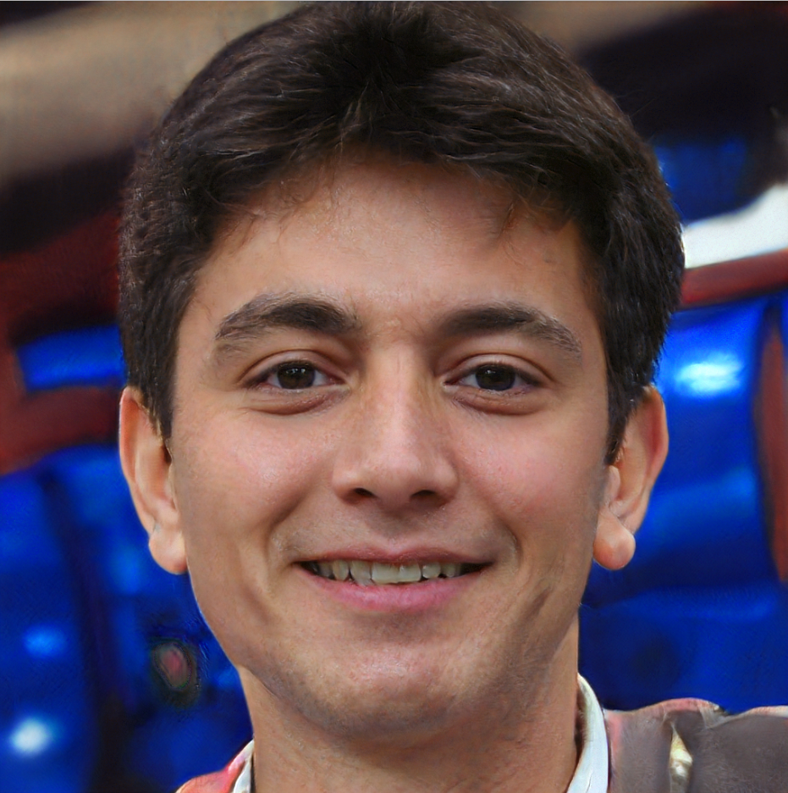
#3
One of the founders of Google
Famous YouTuber

Slide 9

#4
NBA owner
Founded PC company

Slide 10
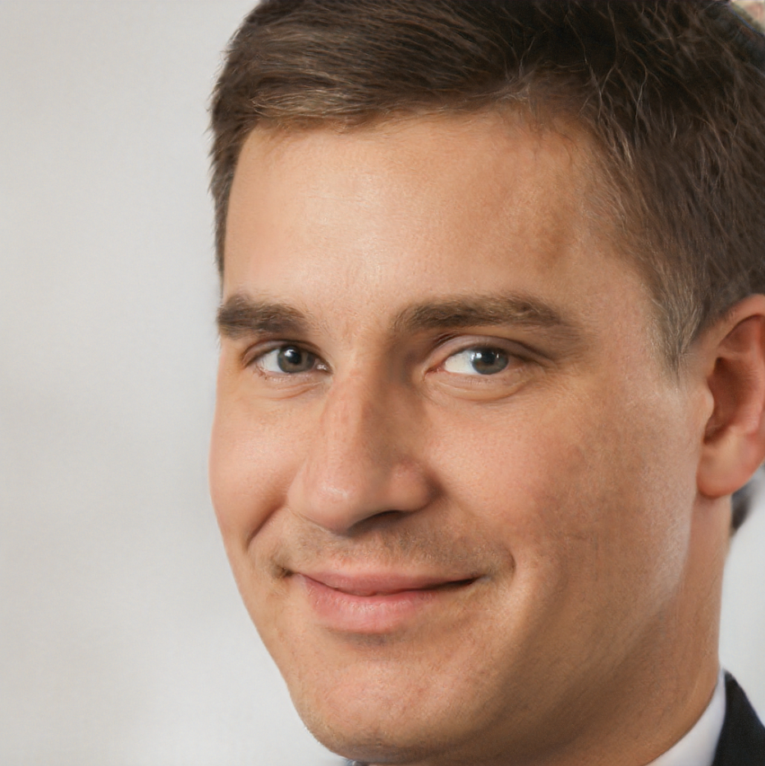
#5
Actor
US senator

Slide 11
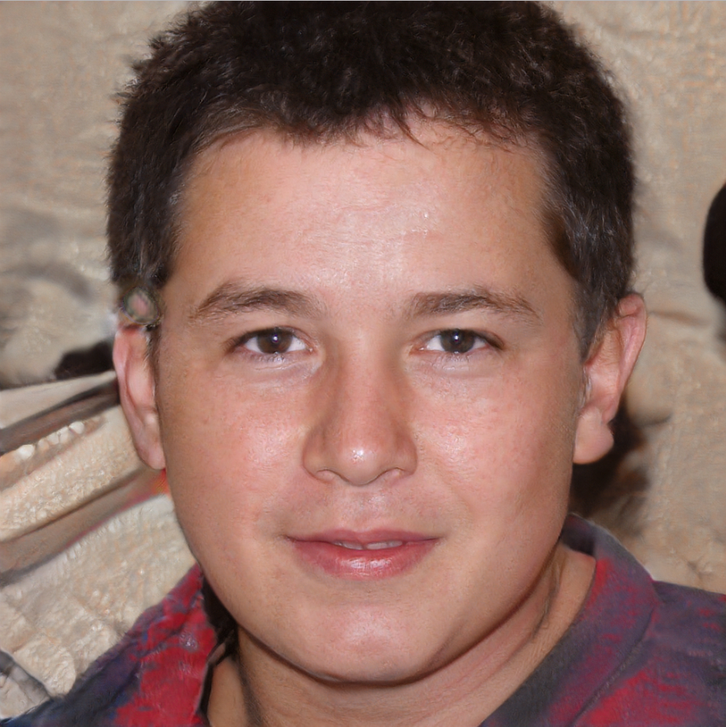
#6
eSports champion
Founded electric car company

Slide 12

#7
Fashion blogger
Former Olympic gymnast

Slide 13

#8
Starred in baby food commercial
Was on cover of Parent magazine

Slide 14

#9
Won high school teacher of the year in NC in 2018
Star on cable television

Slide 15

#10
Author of NY Times bestseller
Pianist

Slide 16
Review responses
How many “A” responses?
How many “B” responses?
Any patterns seen in the responses?
Any common characteristic of all the people shown?

Slide 17
Answer: Quiz not really about facial recognition!
None of the people shown are real people
Each photo was generated by http://thispersondoesnotexist.com
The site uses artificial intelligence to generate the images
generative adversarial network (GAN)
Developed by a software engineer at Nvidia
Now, let’s take a second look at the images...

Slide 18
Summary
Artificial Intelligence (AI) can generate images of faces that are convincingly real
The site http://thispersondoesnotexist.com generates a fake face each time the web page is refreshed
This is an example of the power of AI

